Slide 1
Real Data
Distributed Monitoring
May 2019

Slide 2
Theoretical Status

Slide 3
Spectral Gap
 | Lower Bound | Upper Bound
Convex Bound | Iterative solution | -
Distance L₁ | A loose bound | -

Slide 4
Entropy
 | Lower Bound | Upper Bound
Convex Bound | Function itself (plus extension) | Tangent Plane
Distance L₁ | Binary search | Mathematical closed form

Slide 5
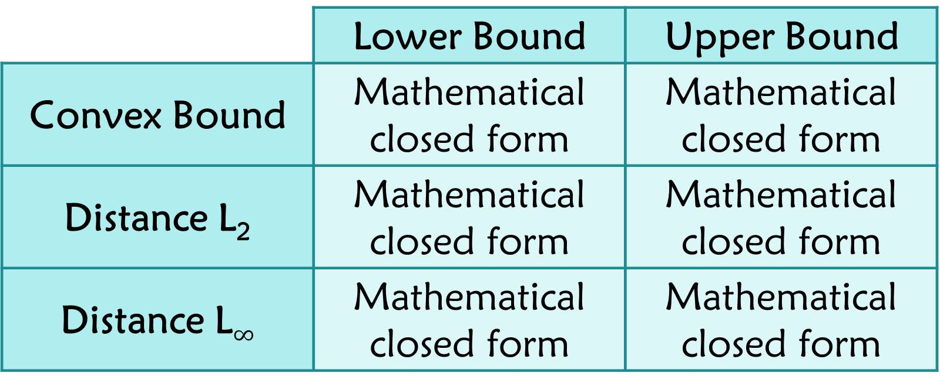
AMS F₂
 | Lower Bound | Upper Bound
Convex Bound | Mathematical closed form | Mathematical closed form
Distance L₂ | Mathematical closed form | Mathematical closed form
Distance L$∞$ | Mathematical closed form | Mathematical closed form

Slide 6
Inner Product
 | Lower Bound | Upper Bound
Convex Bound | Mathematical closed form | Mathematical closed form
Distance L₂ | Mathematical closed form | Mathematical closed form

Slide 7
Real Data Sets Experiments

Slide 8
Research
Bandwidth Consumption
Distributed monitoring scheme
Data dimensionality
# Servers
Linear Ratio

Slide 9
Spectral Gap
YouTube Graph
3,223,589 users
9,375,374 friendship relations
http://konect.uni-koblenz.de/networks/youtube-u-growth

Slide 10
Entropy + AMS F₂
Database accesses in a large communication company
4,702 users
11,654 database entries
1488 hours of usage
https://www.kaggle.com/eyalgut/binary-traffic-matrices/version/2

Slide 11
Inner Product
E-commerce?
Autonomous cars?
Liquor sales in Iowa?
Arnon’s Tweeter data?

Slide 12
AMS F₂

Slide 13
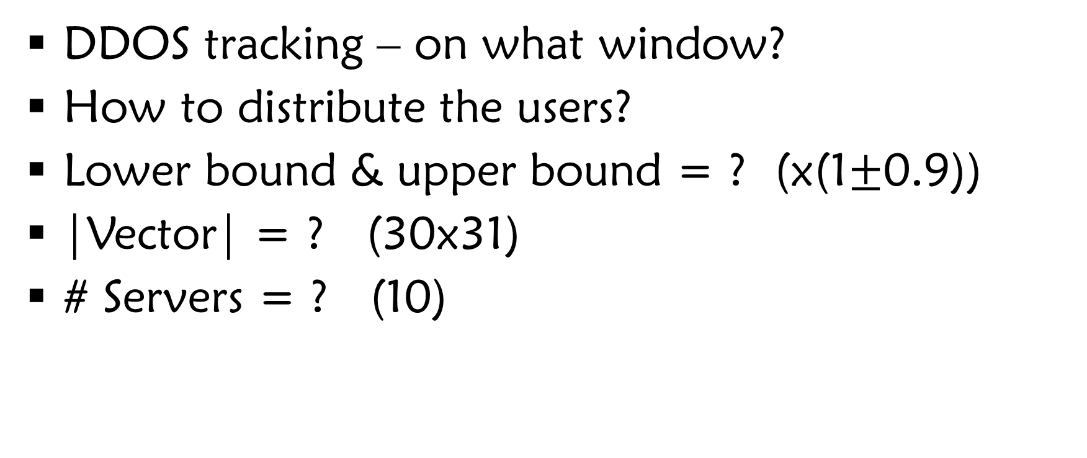
A Few Details
DDOS tracking – on what window?
How to distribute the users?
Lower bound & upper bound = ? (x(1$±$0.9))
|Vector| = ? (30x31)
# Servers = ? (10)

Slide 14
Window = 1, Data

Slide 15
Window = 100, Data
AMS F₂
Time

Slide 16
Round Robin, Bandwidth
Bandwidth
Time

Slide 17
Round Robin, Bandwidth
Bandwidth
x4
Time

Slide 18
Uneven Hashing, Bandwidth
Bandwidth
Time

Slide 19
Uneven Hashing, Bandwidth
Bandwidth
x8
Time

Slide 20
Entropy

Slide 21
TODO

Slide 22
Spectral Gap

Slide 23
TODO

Slide 24
Inner Product

Slide 25
TODO

